Slide 1
Handwritten Digit Recognizer
-By
Aaron Samuel A(097)
N Muhammad Fadil(079)
Rahi Jain(084)

Slide 2
Prerequisite Materials
Keras, OpenCV and TensorFlow have been used in the project.
Youtube link:
https://www.youtube.com/watch?v=PB_zGBsHVQI
Code link:
https://www.nstuts.codes/projectpage

Slide 3
SI No. | Research Name | Links
1 | Recognition of Handwritten Digit using CNN in Python with TensorFlow and Comparison of Performance of various Hidden Layers | Handwritten digit recognition - IEEE
2 | Handwritten Digit Recognition using Machine Learning | Handwritten_Digit_Recognition_Using_ML
3 | Deep Learning Handwritten Digit Recognition using Convolutional Neural Network | Deep_Learning_Handwritten_Digit_Recognition_using_CNN
4 | Handwritten Digit Recognition using various Machine Learning Algorithms and Models | HDR using various machine learning algorithms IJIRCST
5 | Handwritten Digit Recognition using Machine Learning | HDR using ML
6 | Handwritten Digit Recognition using Machine Learning | HDR using Machine Learning

Slide 4
Abstract
Digital recognition is an important issue when it comes to computer vision as handwritten digits are not of same size, thickness, position and direction. in this case by the way, various difficulties should be considered find the handwritten digital recognition problem.
Unique and a variety of creative styles for different people moreover have an influence on the model.
Handwritten digit recognition is a strategy to view the rewritten digits again. It has a wide variety of applications, for example, scheduled bank checks, post offices and tax documents and so on.
The purpose of this project is to use the classification algorithm to identify handwritten digits. Background results are probably the most widely used Machine Learning Algorithms such as SVM, KNN and RFC and in-depth reading calculations like CNN multilayer using Keras and Theano and Tensorflow.

Slide 5
Problem Statement
The MNIST Problem is a dataset developed for evaluating machine learning models on the handwritten digit classification problem.
The dataset was constructed from a number of scanned document dataset available from the National Institute of Standards and Technology (NIST). This is where the name for the dataset comes from, as the Modified NIST or MNIST dataset.
Images of digits were taken from a variety of scanned documents, normalized in size and centered. This makes it an excellent dataset for evaluating models, allowing the developer to focus on the machine learning with very little data cleaning or preparation required.
Each image is a 28 by 28 pixel square (784 pixels total). A standard split of the dataset is used to evaluate and compare models, where 60,000 images are used to train a model and a separate set of 10,000 images are used to test it.
It is a digit recognition task. As such there are 10 digits (0 to 9) or 10 classes to predict. Results are reported using prediction error, which is nothing more than the inverted classification accuracy.
Excellent results achieve a prediction error of less than 1%. State-of-the-art prediction error of approximately 0.2% can be achieved with large Convolutional Neural Networks.

Slide 6
Proposed Solution
In recent years, neural networks and conventional neural network currently provide the best solutions to many problems in handwritten digit recognition.
A novel hybrid model for handwritten digit recognition would be able to solve the MNIST problem. We have to train the model in such a way that the hybrid model automatically extracts features from the raw images and generates the predictions.

Slide 7
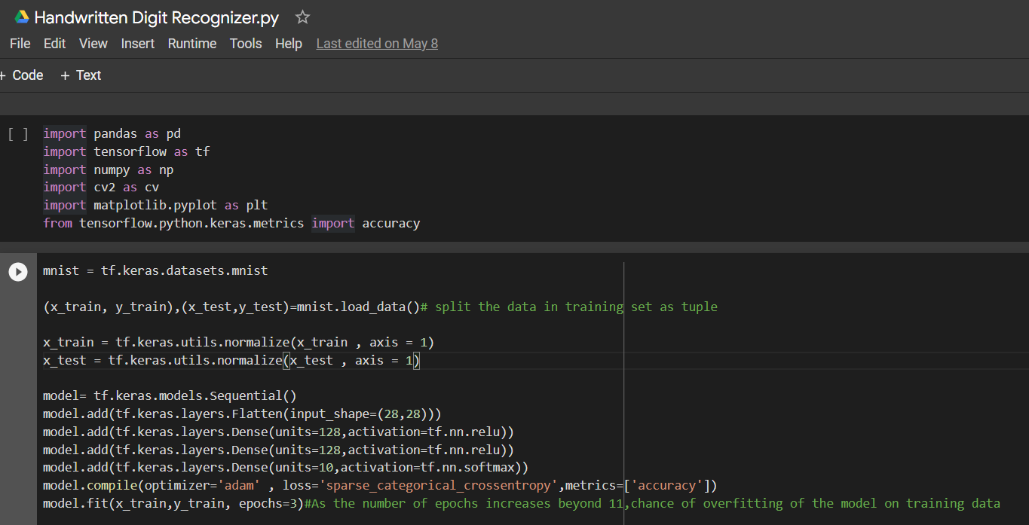
Code for our project

Slide 8
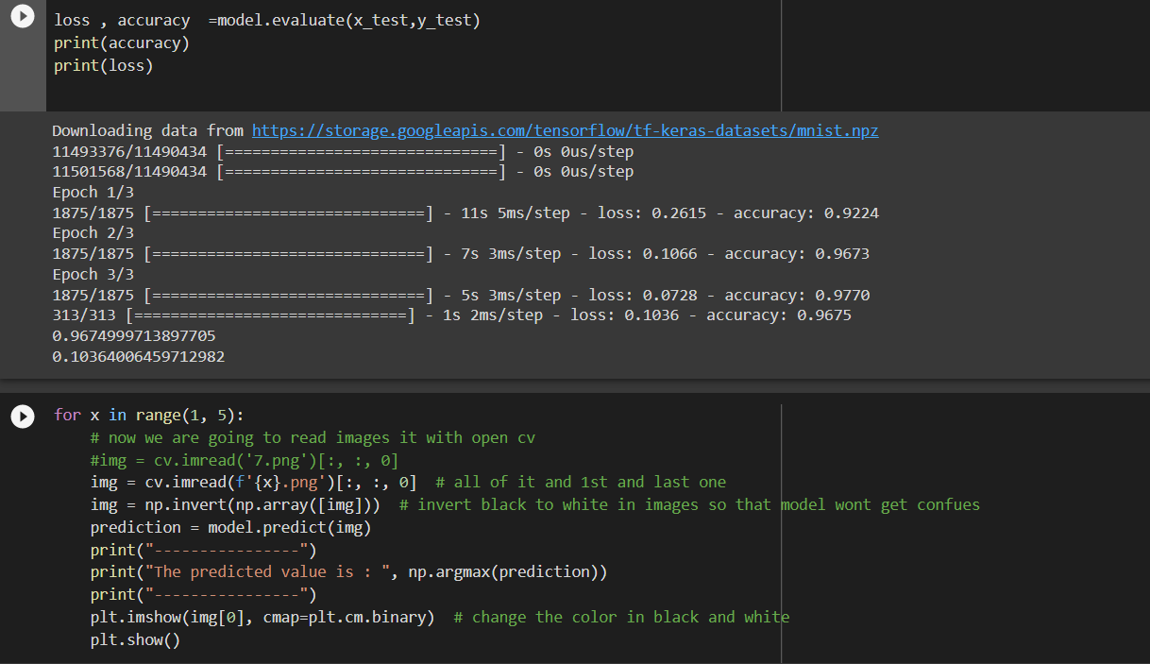

Slide 9
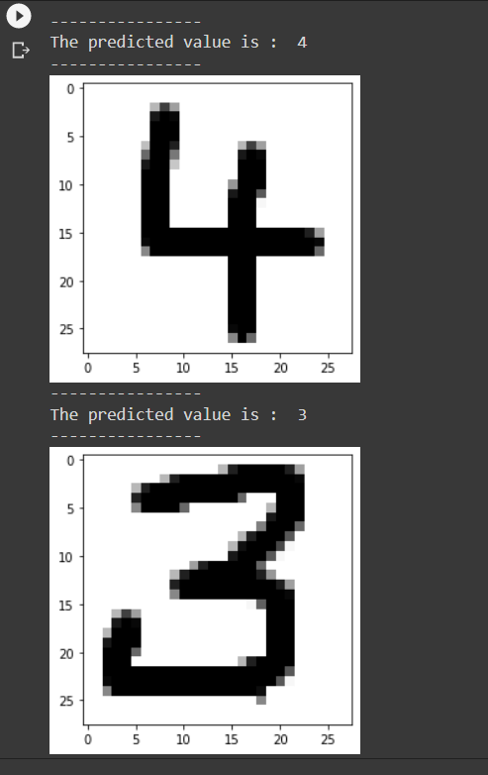
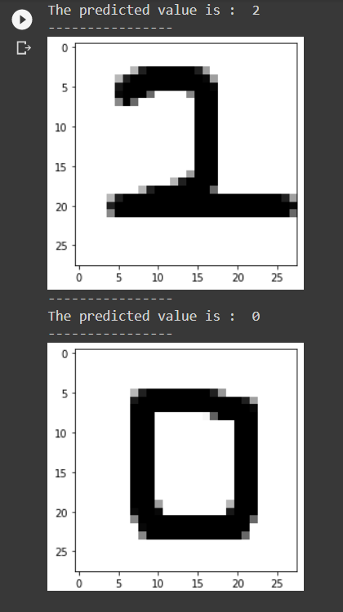
Output

Slide 10
Obtained Results
Case | Number of Hidden Layers | Minimum Training Accuracy |  | Maximum Training Accuracy |  | Batch Size | Overall Performance Accuracy(%)
 |  | Epoch | Accuracy(%) | Epoch | Accuracy(%)
1 | 1 | 1 | 95.80 | 3 | 96.76 | 10 | 96.28
2 | 3 | 1 | 95.69 | 4 | 97.15 | 10 | 96.42
3 | 1 | 2 | 93.28 | 3 | 96.93 | 10 | 96.44
4 | 2 | 1 | 96.51 | 5 | 97.51 | 10 | 97.01

Slide 11
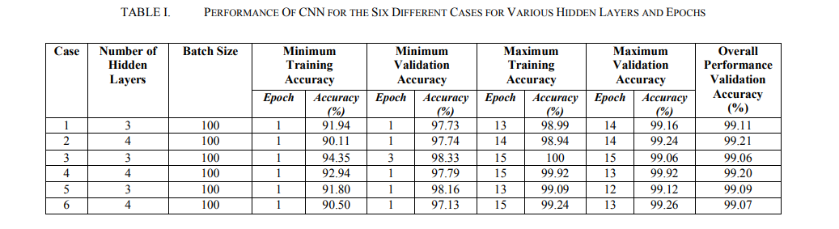
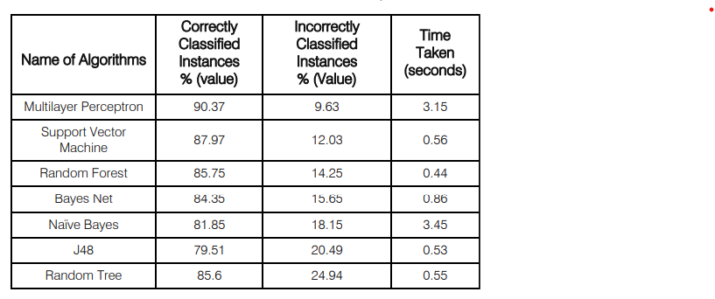
Comparison with other results

Slide 12
Contributions of each team member
Aaron Samuel A - has trained and built the neural network model for the handwritten digit recognizer.
N Fadil - has helped to create the handwritten digit recognizer using OpenCV and TensorFlow
Rahi Jain – has extensively searched for research papers for references to compare difference in the output.

Slide 13


